Slide 1
Chapter-2 Digital Image Fundamentals

Slide 2
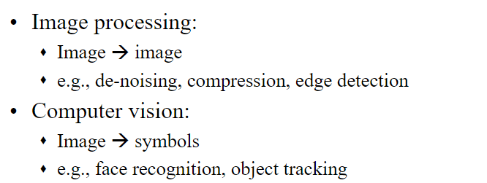
Image Processing Vs. Computer Vision

Slide 3
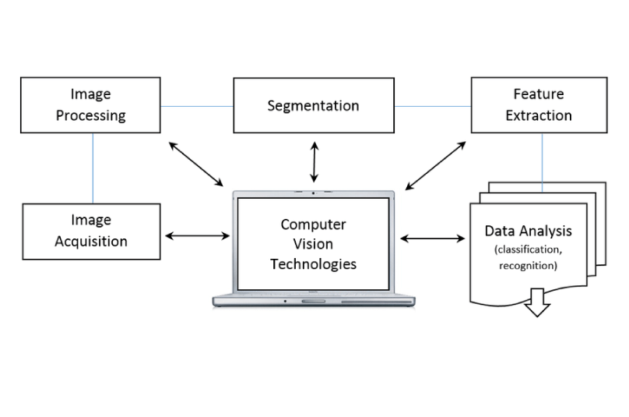

Slide 4
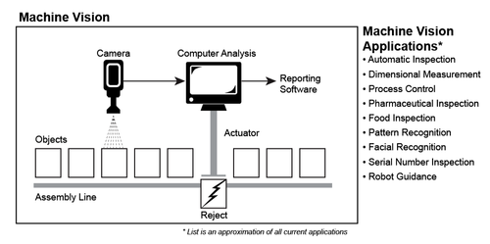

Slide 5
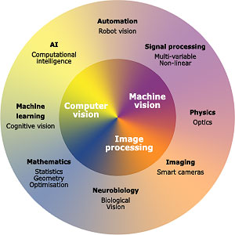

Slide 6
Image Types
Binary Image
Grayscale image
Color image
Volume image
Multispectral images

Slide 7
Digital Image Fundamentals

Slide 8
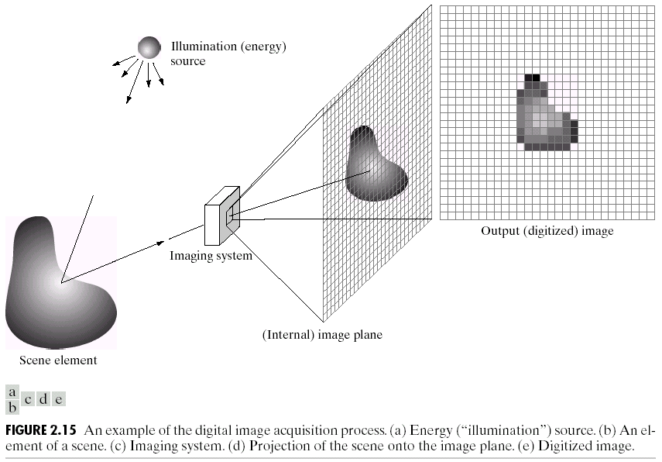
Image Formation Model

Slide 9
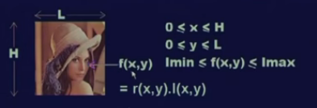
Value of f(x,y) is characterized by:
f(x,y) = i(x,y)* r(x,y)
Where
0 < i(x,y) < ∞
0 < r(x,y) <1
Illumination
Reflectance

Slide 10
Image sampling and quantization
Digitalization of an analog signal involves two
operations:
--Sampling, and
--Quantization.
Both operations correspond to a discretization of a quantity, but in different domains.

Slide 11
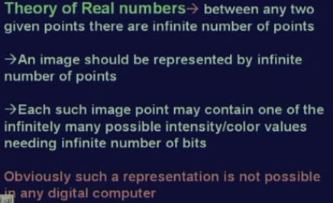
problem

Slide 12
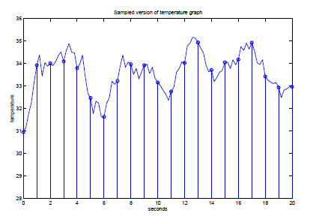
Sampling
Sampling corresponds to a discretization of the space.

Slide 13
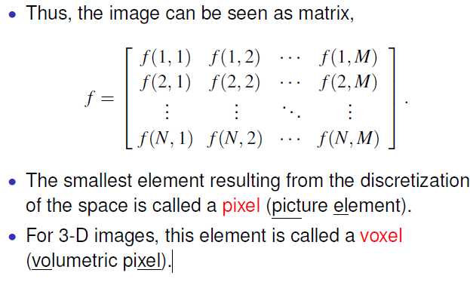

Slide 14
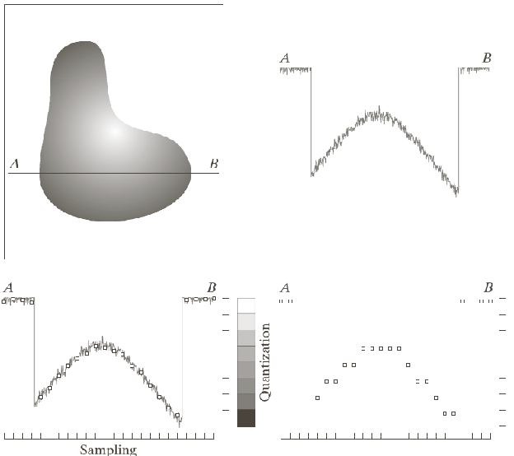
Quantization
Quantization corresponds to a discretization of the intensity values

Slide 15

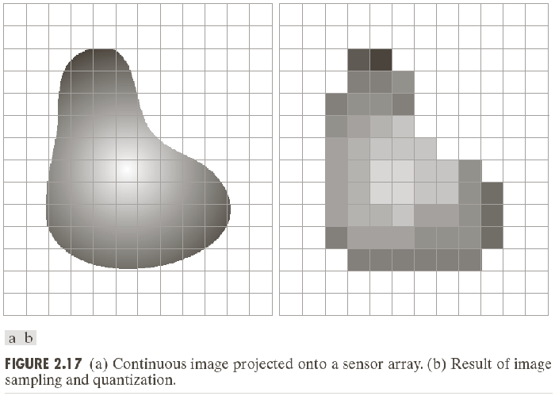

Slide 16
Representing Digital Image

Slide 17
Important Terms
Intensity Level
L = 2^{k}
2⁸ = 256
^{[0, L-1]}
Dynamic range
Image contrast
No. of bits
b = M * N * k

Slide 18
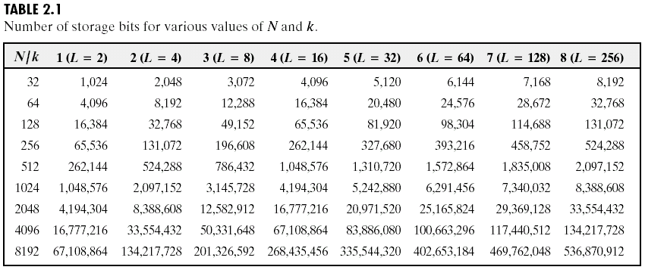

Slide 19
Resolution
Spatial Resolution: No of pixels per unit dist
Intensity Resolution: No. of bits used to quantize intensity

Slide 20
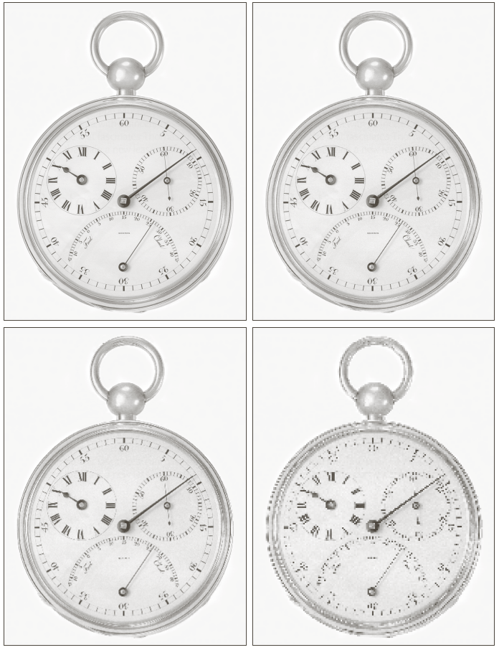
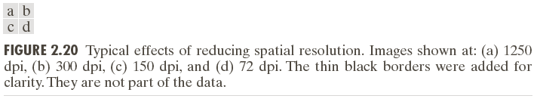

Slide 21
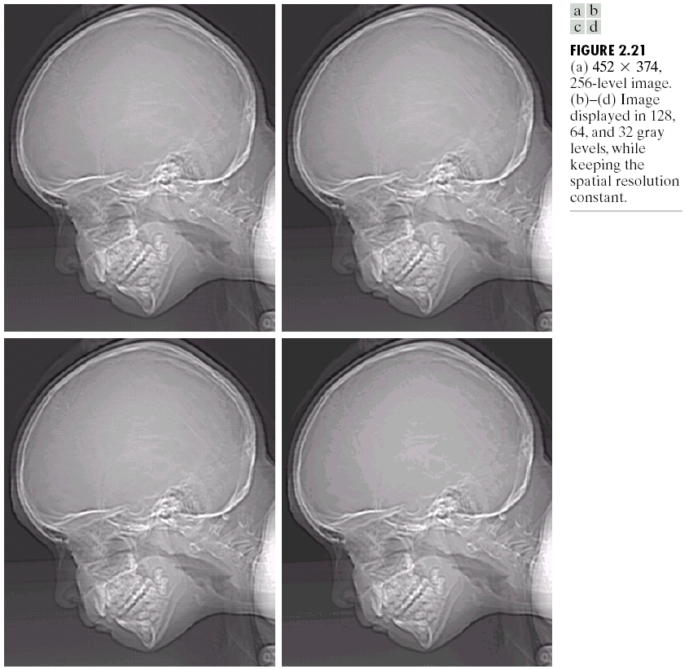
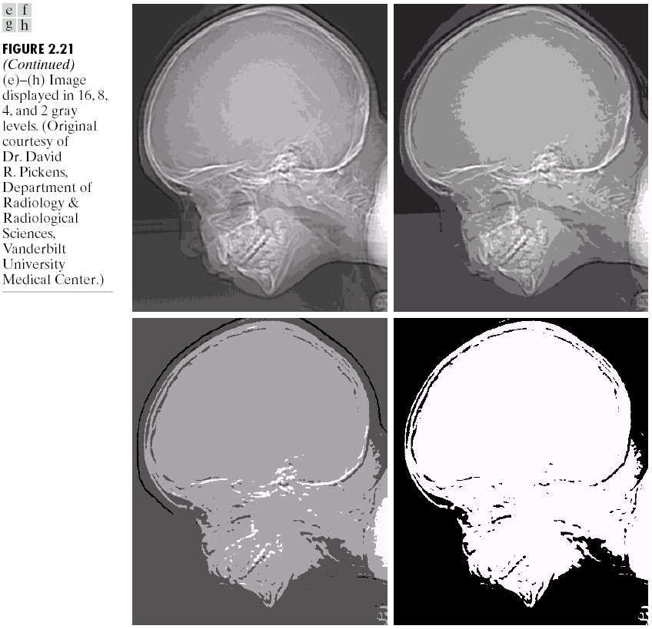

Slide 22
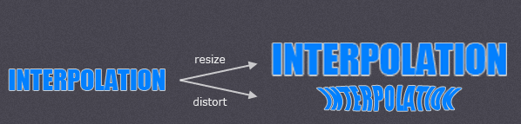
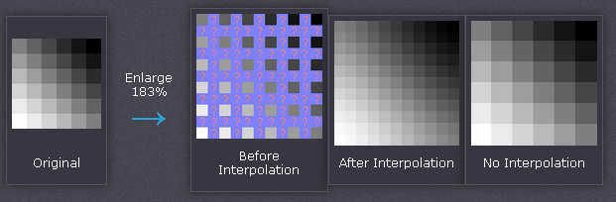
Interpolation

Slide 23
Nearest neighbor is the most basic and requires the least processing time of all the interpolation algorithms because it only considers one pixel — the closest one to the interpolated point.
Bilinear interpolation considers the closest 2x2 neighborhood of known pixel values surrounding the unknown pixel. It then takes a weighted average of these 4 pixels to arrive at its final interpolated value. This results in much smoother looking images than nearest neighbor.
Bicubic goes one step beyond bilinear by considering the closest 4x4 neighborhood of known pixels — for a total of 16 pixels. Since these are at various distances from the unknown pixel, closer pixels are given a higher weighting in the calculation. Bicubic produces noticeably sharper images than the previous two methods, and is perhaps the ideal combination of processing time and output quality.

Slide 24
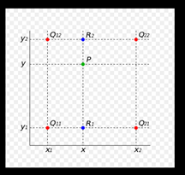
Bilinear

Slide 25


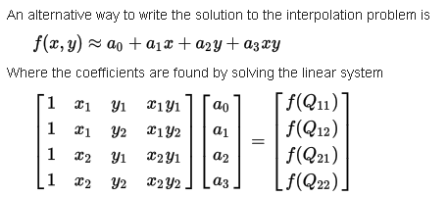

Slide 26
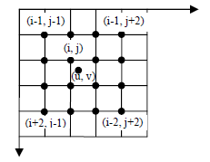
Bicubic

Slide 27
Interpolation

